Slide 1
MSDM 5003 Week 12 23 November 2023 Beyond the Basic Games
Outline:
1. The Wealth Game
2. Testing with Hang Seng Index
3. Evolutionary Minority Games
4. Adaptive Minority Games
5. The Kolkata Paise Restaurant Problem
6. Agent-Based Models for Explaining the Power Law for Price Fluctuations Herding Model: Cont-Bouchaud
Cont-Bouchaud Model on a Lattice: Percolation Model

Slide 2
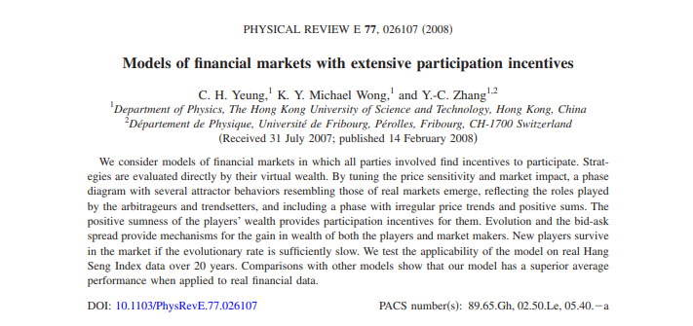
1. The Wealth Game
C. H. Yeung (楊志豪)¹
K. Y. Michael Wong (王國彝)¹
Y. C. Zhang (張翼成)^{1,2}
¹HKUST, ²Université de Fribourg

Slide 3

Group Outing, 1 January 2007
Zhang
Wong
Yeung

Slide 4
Introduction
The issue of participation incentives
Wealth-based payoff scheme
Phase diagram
Market-makers
Evolving markets
Tests with Hang Seng Index

Slide 5
Participation Incentives
In financial markets, the minority wins.
If there are more buyers than sellers, the sellers win, and vice versa.
The Minority Game (MG) is an agent-based model successfully applied to financial markets.
Since MG is a negative-sum game, it cannot explain why agents have participation incentives.

Slide 6



Market Modeling: Agents
There are N agents in the market.
At every time step, each agent makes a decision to buy, sell or hold.
An agent follows one of her strategies to make decisions.
She chooses the strategy with the highest payoff among those she owns.

Slide 7
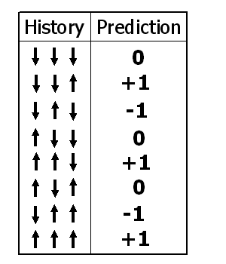
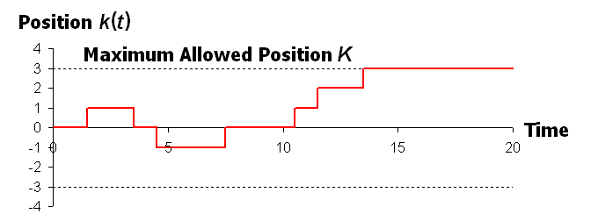
Strategies and Maximum Positions
A strategy prescribes an action given the previous price movement.
All strategies have at least one buy and sell decisions.
History
Action

Slide 8


Market Modeling: Payoffs
Individual decisions
Collective actions
Price
changes!!
Price rises/falls when the sellers/buyers are the minority.
Payoffs are updated according to price changes.
In MG, the payoff of a strategy changes by ±(price change) for sell/buy decisions (neutral to hold decisions).

Slide 9
Wealth-based Payoff
The payoff of MG is myopic:
only considers one-step effects
neglects historical effects of previous decisions
For example, it is neutral to hold decisions:
Holding a long position when price rises is good.
Holding a short position when price falls is good.
Proposed wealth-based payoff scheme: the payoff of a strategy = total wealth (cash + stock) it brings were its decisions followed in the market history.

Slide 10
Price Sensitivity
Price Sensitivity
Sensitivity of stock price on agents’ collective actions
Define γ :
Price
change
Individual decisions
Collective actions
Price movement = (Collective actions)^{γ}

Slide 11



Market Impact
Market impact: The impact of synchronized decisions from peer investors during transaction
Define β
Market
impact !!
Synchronized
Actions !!
Transaction price
= Current price
+ β (Synchronized price movement)

Slide 12
(1) Price sensitivity γ
Price movement = (Collective actions)^{γ}
(2) Market Impact β
Transaction price
= Current price
+ β (Synchronized price movement)
The 2 aspects we would like to put in the model !!

Slide 13
Decision of agent a_{i}(t) = +1, 0, −1
Real Price:
Transaction Price P_{T}(t)
= Price in between P(t+1) and P(t)
Collective
actions !!
Price
Sensitivity!!
Market Impact !!

Slide 14
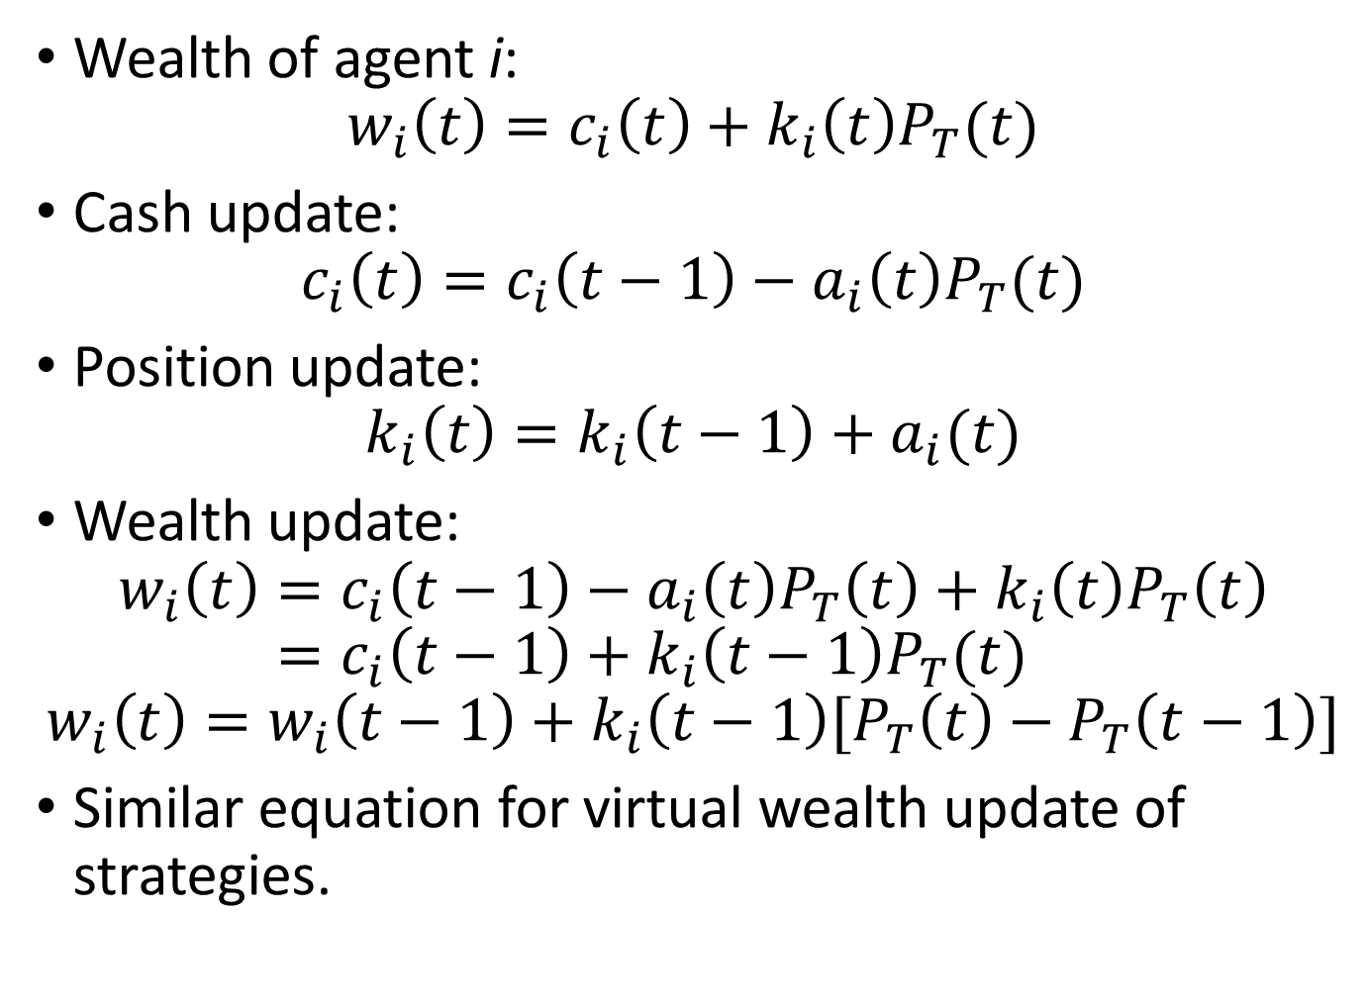
Wealth of agent i:
$$w_{i}\left(t\right)=c_{i}\left(t\right)+k_{i}\left(t\right)P_{T}(t)$$
Cash update:
$$c_{i}\left(t\right)=c_{i}\left(t−1\right)−a_{i}\left(t\right)P_{T}(t)$$
Position update:
$$k_{i}\left(t\right)=k_{i}\left(t−1\right)+a_{i}(t)$$
Wealth update:
$$w_{i}\left(t\right)=c_{i}\left(t−1\right)−a_{i}\left(t\right)P_{T}\left(t\right)+k_{i}\left(t\right)P_{T}\left(t\right)$$
$$=c_{i}\left(t−1\right)+k_{i}\left(t−1\right)P_{T}(t)$$
$$w_{i}\left(t\right)=w_{i}\left(t−1\right)+k_{i}\left(t−1\right)[P_{T}\left(t\right)−P_{T}\left(t−1\right)]$$
Similar equation for virtual wealth update of strategies.

Slide 15
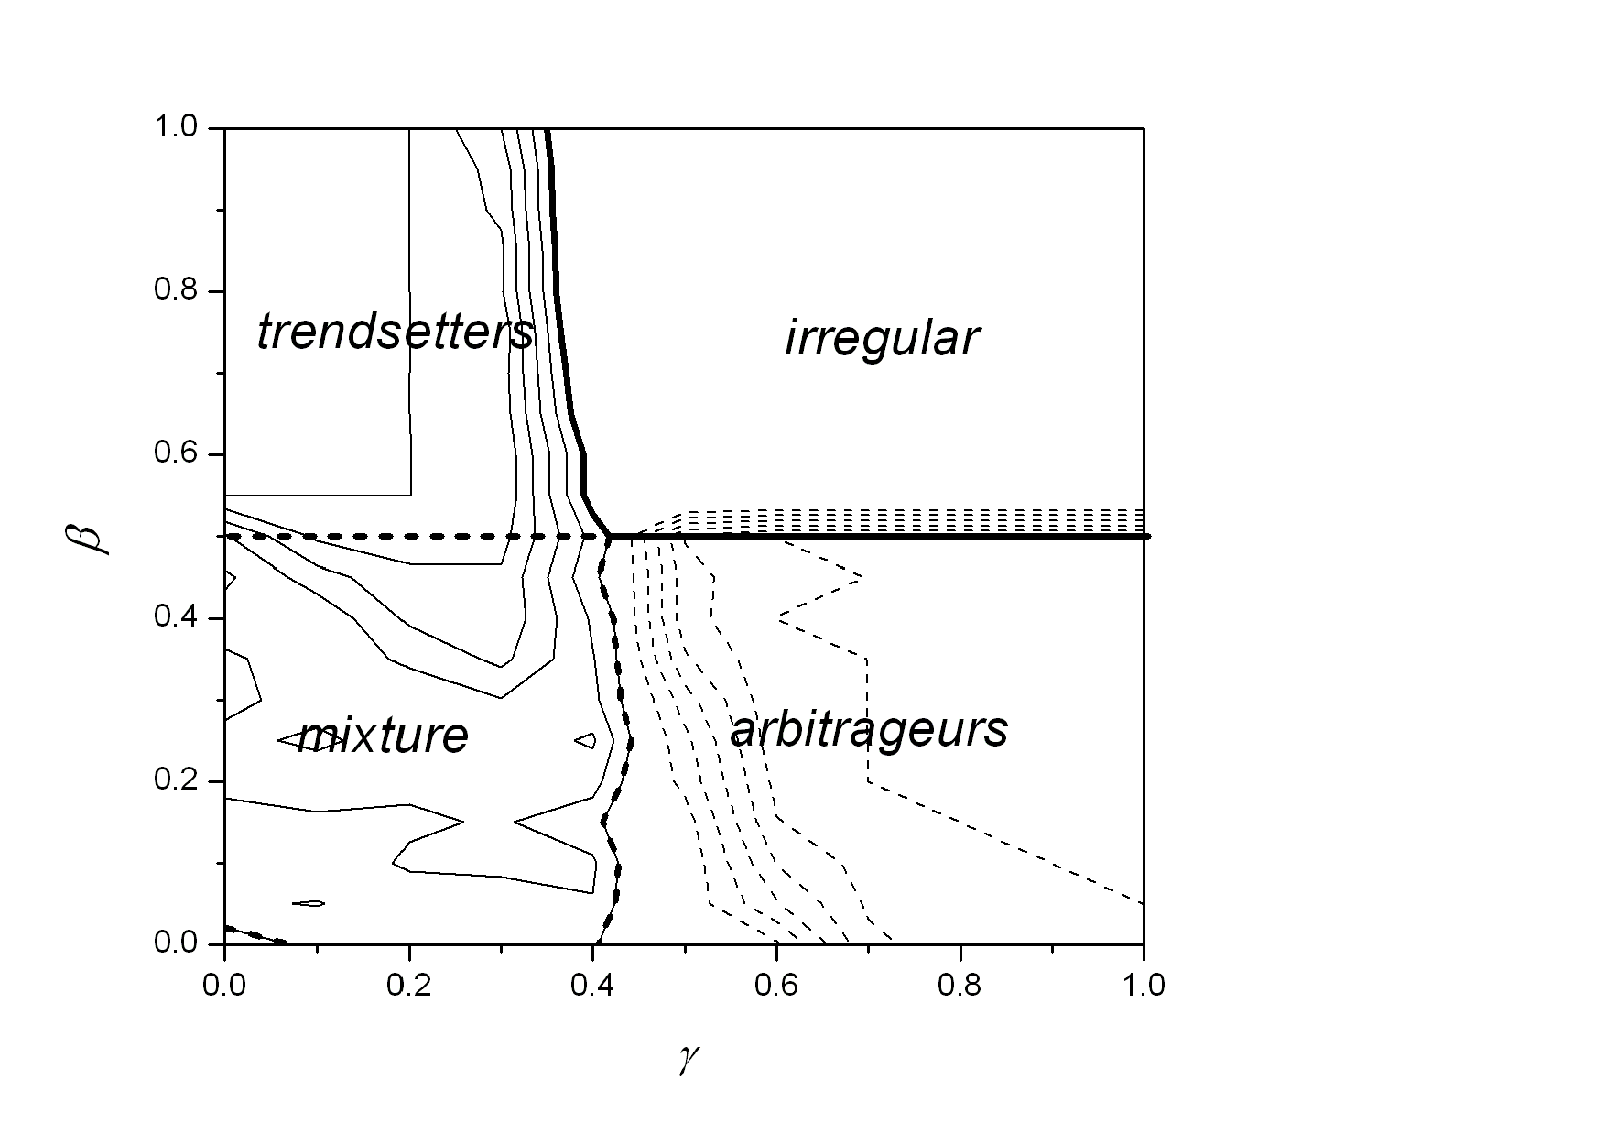
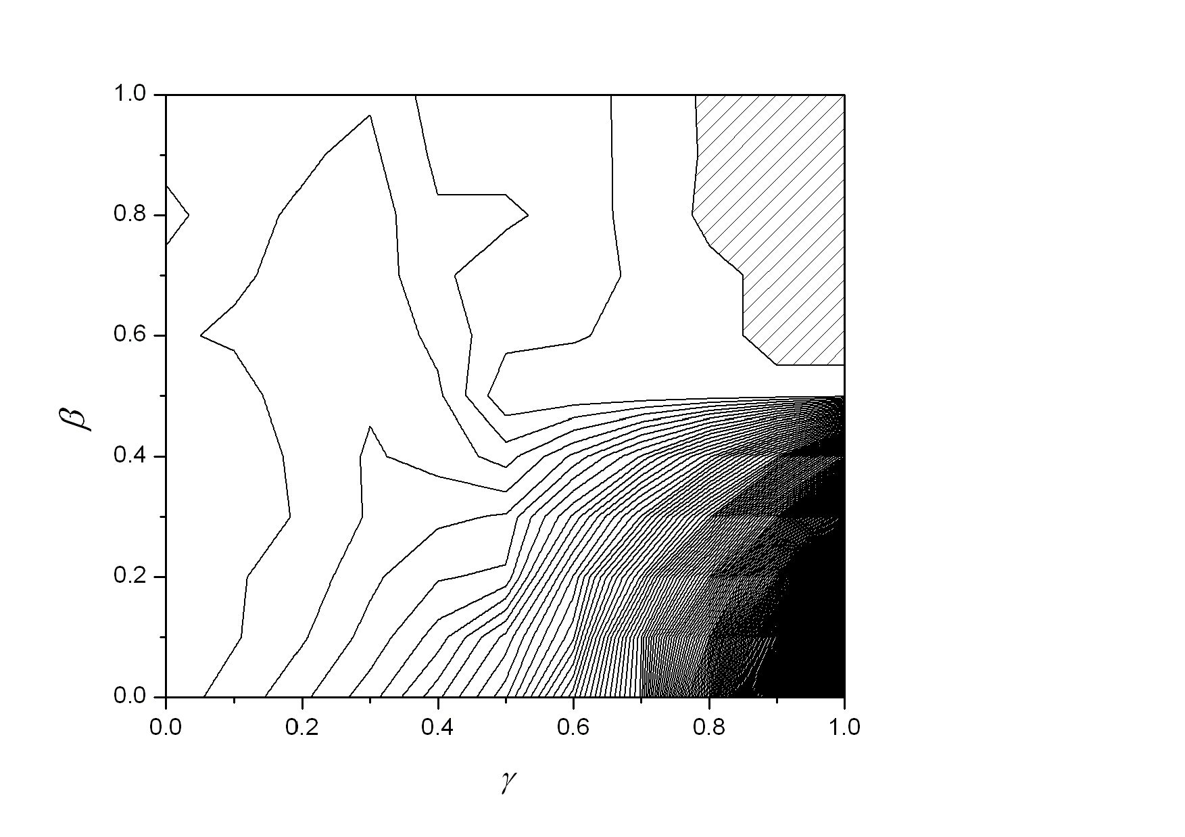
Results
Negative
Positive
Final State
of the system
Agents’ wealth

Slide 16
Irregular phase ??
Trendsetters’ phase ??
Phase Diagram of
Final State
Mixture phase ??
Arbitrageurs’ phase ??

Slide 17
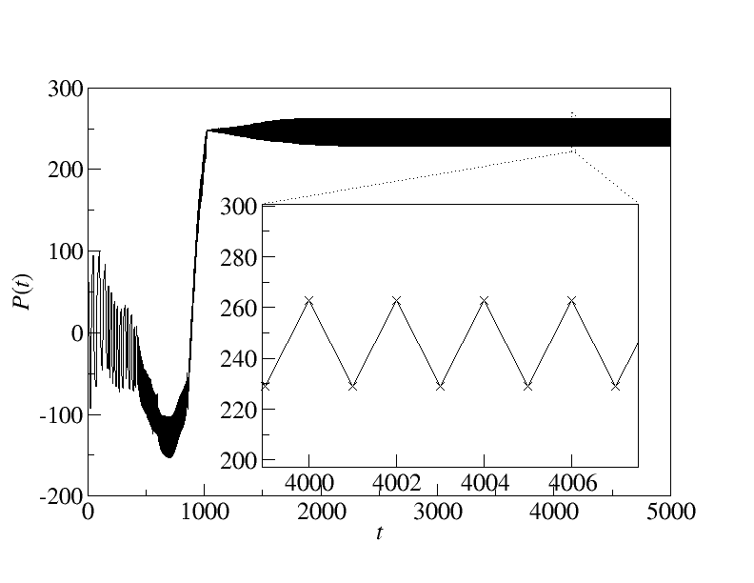
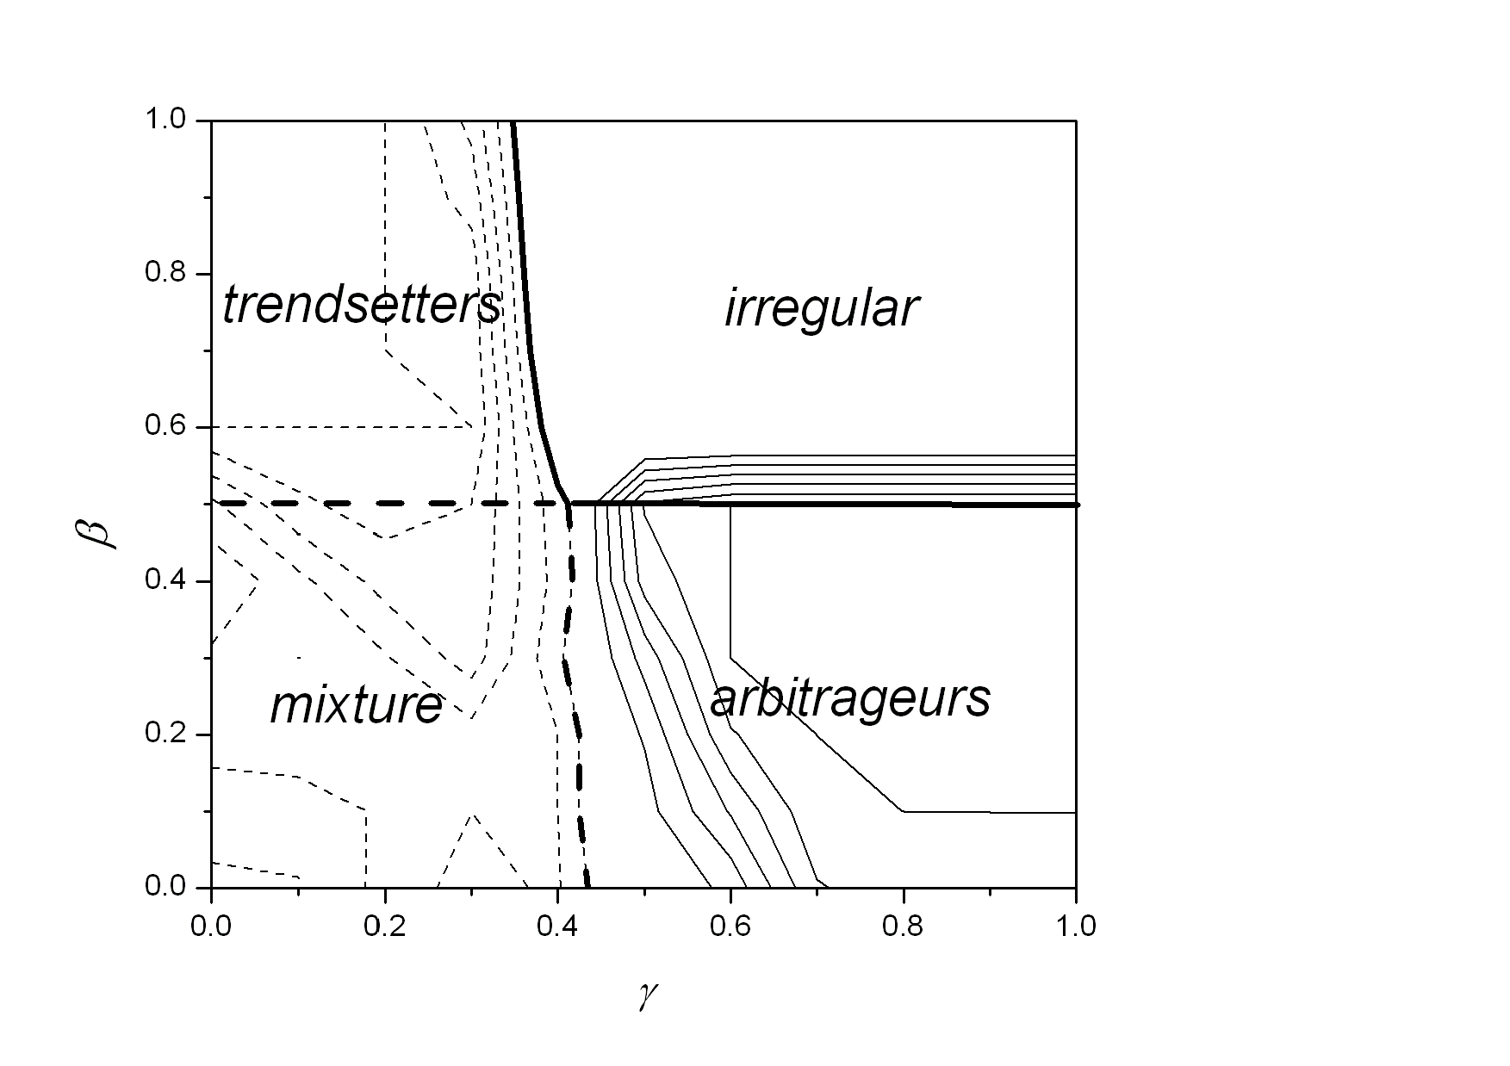
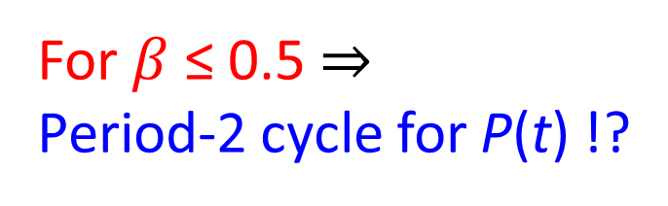
Arbitrageurs’ Phase
sell!
buy!
For $β$ ≤ 0.5 ⇒
Period-2 cycle for P(t) !?
Gain!!

Slide 18
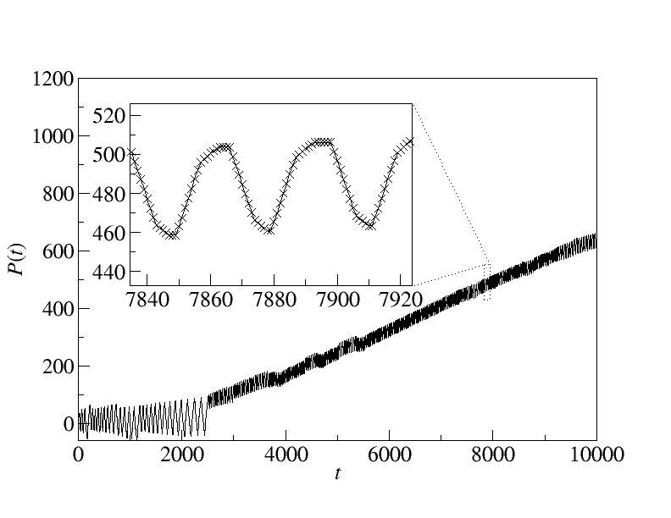
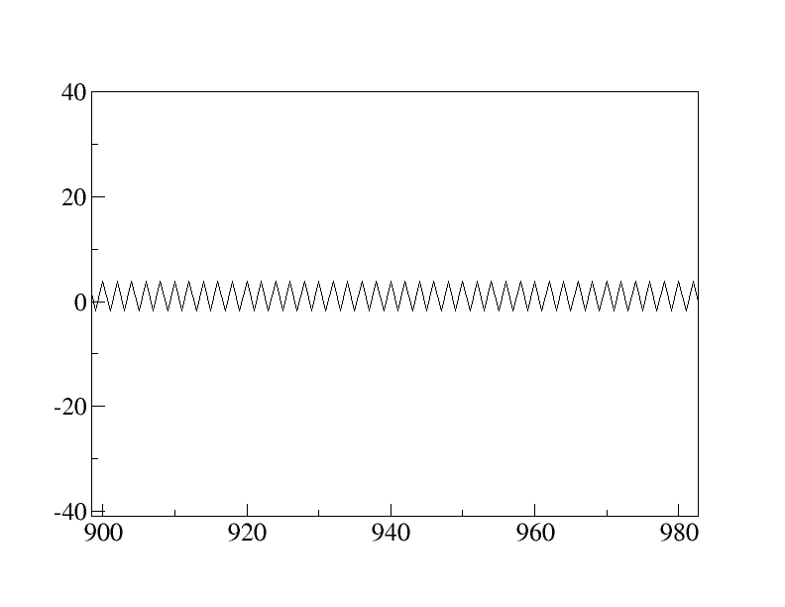
Trendsetters’ Phase
What are
they doing?
Periodic with characteristic pattern
Period much longer than period 2 !!
VS
Arbitrageurs’ phase

Slide 19
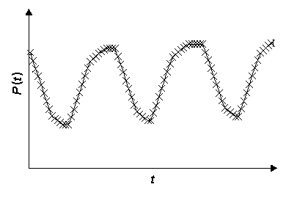

Trendsetter state
Trendsetters
(winners)
Trendfollowers
(winners)
Late followers
(losers)
Start to sell !!
(Set up the downward trend)
Follow the trend !!
I am late...
We didn’t teach them to set up and follow trend !!
But they do it !!!

Slide 20
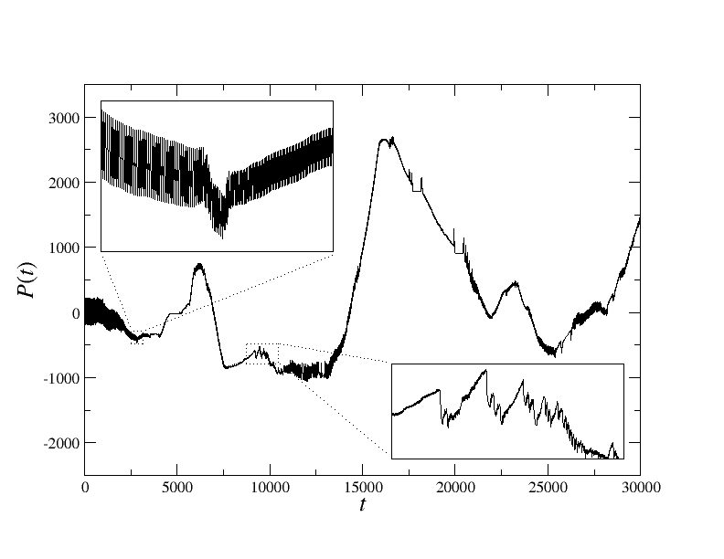
Irregular Phase
Short time fluctuations embedded in long time fluctuations.
Fat tail distributions of price change.

Slide 21
Which Part of the Phase Diagram Resembles Real Markets Most?
Agent’s wealth
Negative
Positive

Slide 22
2. Testing with Hang Seng Index
Interest rates
Asian crisis
Gulf War
June 4th
Black Monday
Recovery
SARS
911 attack
1987
2007
Dot-com bubble

Slide 23
Comparison
 | Payoff update
Wealth Game | last position × trans. price change
Minority Game | −decision × price change
$-Game | decision × last price change
Majority Game | decision × price change
Decision: +1 for buy, −1 for sell

Slide 24
Tests with Fixed Maximum Position
Wealth Game has the best average wealth.

Slide 25
An Interesting Twist
 | Wealth Game | Minority Game | $-Game | Majority Game
Average wealth | 0.6 | −0.12 | 0.03 | 0.08
Best wealth | 3.31 | 4.51 | 3.35 | 3.38
Wealth Game has the best average wealth.
Minority Game has the richest agents (sacrificing the performance of other agents).

Slide 26
Tests with Wealth-Based Max. Pos.
Initial wealth of all agents = 5 × HSI price
Maximum position of an agent
= current wealth / current HSI price (wealth > 0)
= 0 (wealth < 0)
An agent cannot buy/sell when her wealth falls below the current HSI price.

Slide 27
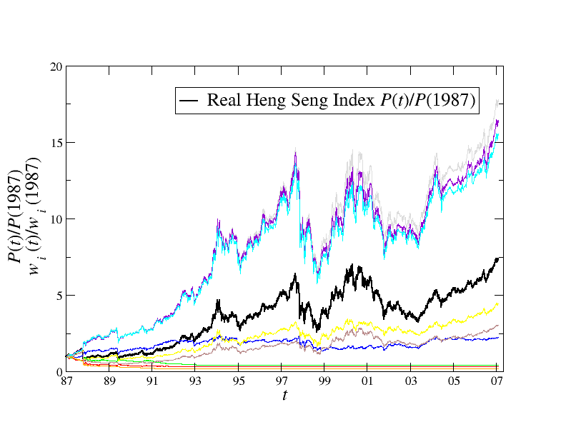
Results (HSI from 1987 – 2007)
Best 3
among
10000
Agents
x 17 times
HSI
x 7.5 times
5 random
agents
5 worst
agents

Slide 28
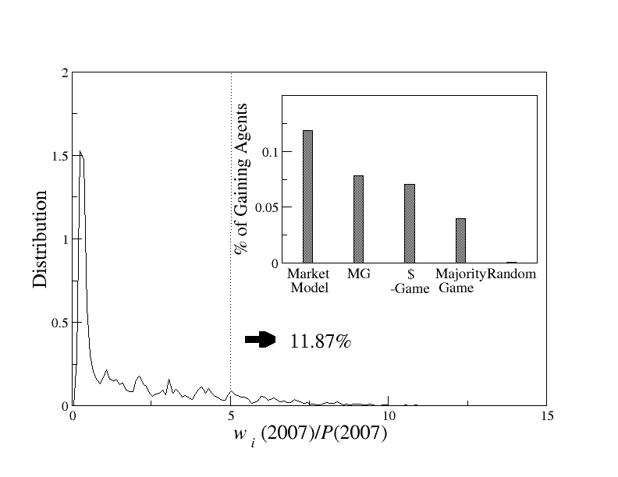
Comparison with other models: % of gaining agents
Wealth grows
slower than
inflation
Wealth grows
faster than
inflation
≈10%

Slide 29
Comparison
 | Wealth Game | Minority Game | $-Game | Majority Game
Average wealth | 1.85 | 1.47 | 1.40 | 1.31
% gaining agents | 10.4 | 8.68 | 6.40 | 5.45
Worst wealth | 0.13 | 0.13 | 0.13 | 0.12
Best wealth | 11.16 | 17.15 | 11.13 | 10.88

Slide 30
Trendy Period (2003-2007)

Slide 31
Trendy Period: Wealth Distribution

Slide 32
Trendy Period: Comparison
 | Wealth Game | Minority Game | $-Game | Majority Game
Average wealth | 2.82 | 2.03 | 2.48 | 2.49
% gaining agents | 0 | 0 | 0 | 0.001
Worst wealth | 0.88 | 0.88 | 0.87 | 0.87
% bankruptcy | 0 | 0 | 0 | 0
Best wealth | 4.38 | 4.42 | 4.43 | 5.01

Slide 33
Rugged Period (1996-2001)

Slide 34
Rugged Period: Wealth Distribution

Slide 35
Rugged Period: Comparison
 | Wealth Game | Minority Game | $-Game | Majority Game
Average wealth | 3.46 | 4.02 | 3.61 | 3.70
% gaining agents | 13.0 | 26.3 | 21.4 | 19.8
Worst wealth | 0.91 | 1.12 | 0.99 | 0.66
% bankruptcy | 0 | 0 | 0 | 0
Best wealth | 10.8 | 17.2 | 10.7 | 11.5

Slide 36
Overall Assessment
Wealth Game characteristics:
Faithfully represents wealth considerations in strategies
Have long memory due to its position dependence
Works better when history can guide
Works worse with trend reversals
Works better in long term investment than short term speculation

Slide 37
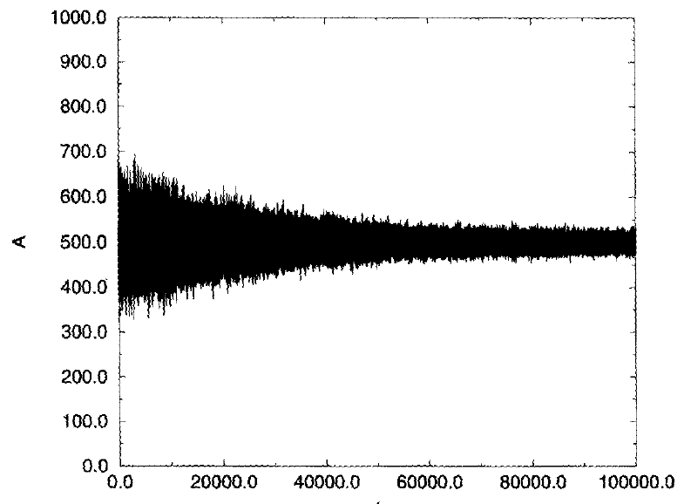
3. Evolutionary Minority Games¹
The worst player is replaced by a new one after some time-steps.
The new player is a clone of the best player.
The virtual scores of the new player’s strategies are reset to zero.
Mutation: Replace one strategy of the best player by a new one.
Result: The population is able to learn by reducing their fluctuations.
¹ Challet D and Zhang Y-C (1997) Emergence of cooperation and organization in an evolutionary game. Physica A 246 407-418.

Slide 38
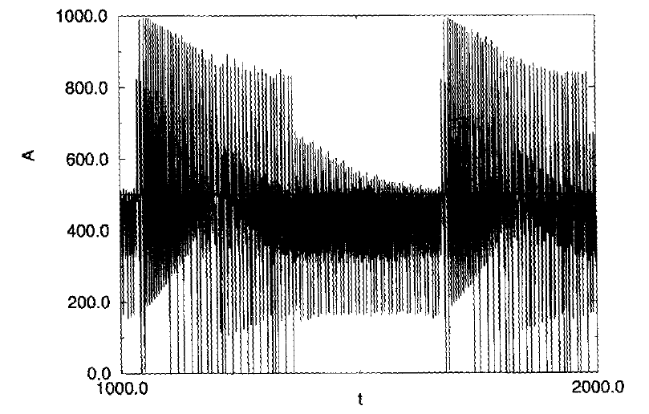
Comparison
Comparison with the case with no mutation
Conclusion: Diversity is important.

Slide 39
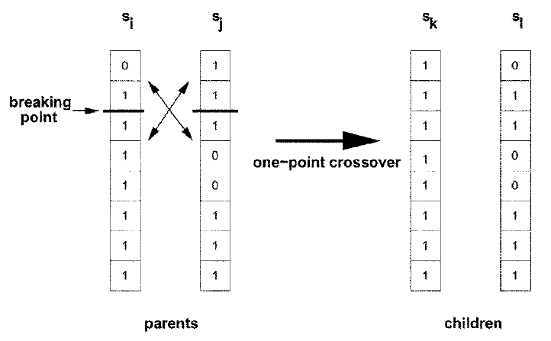
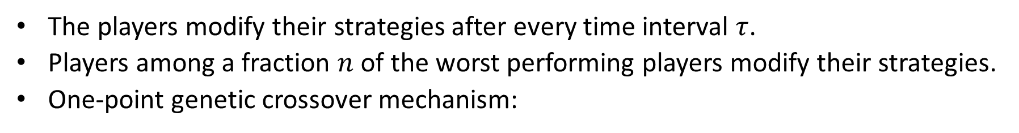
4. Adaptive Minority Games²
The players modify their strategies after every time interval $τ$.
Players among a fraction $n$ of the worst performing players modify their strategies.
One-point genetic crossover mechanism:
² Sys-Aho M, Chakraborti A, and Kaski K (2003) Biology helps you to win a game. Physica Scripta T 106 32.

Slide 40
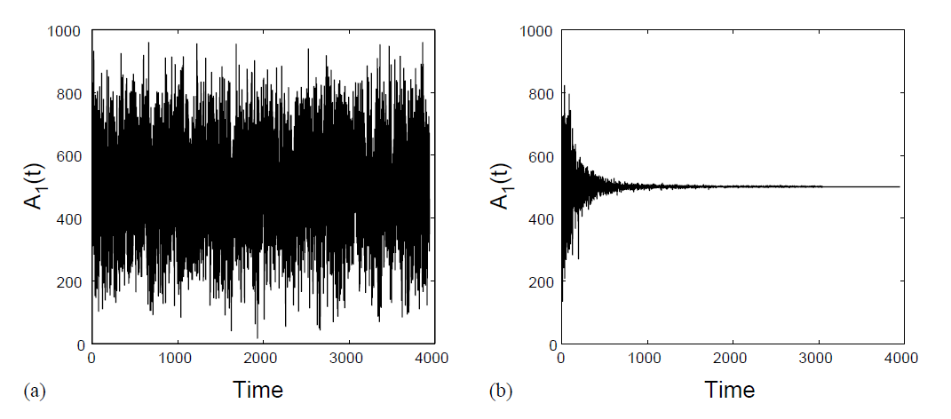
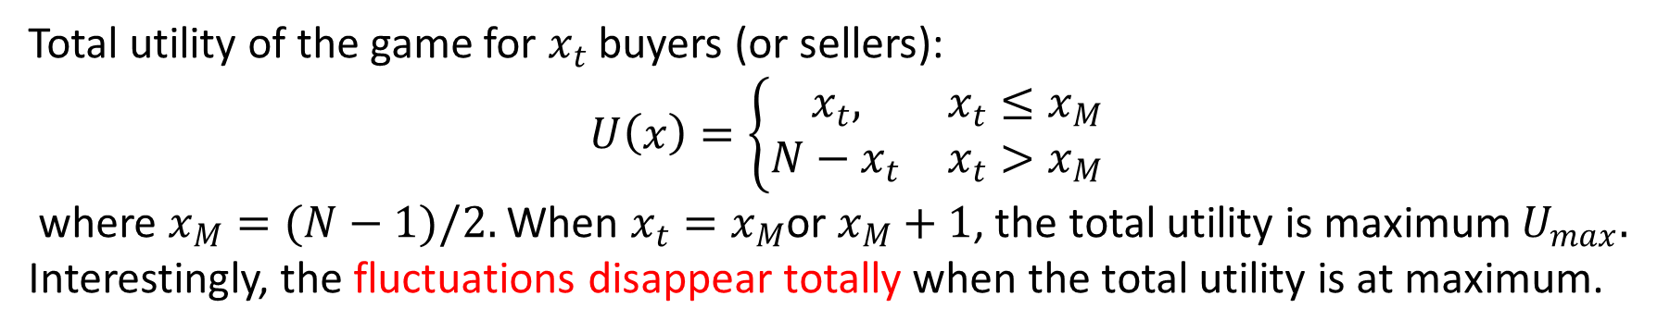
Fluctuations Disappear!
Total utility of the game for $x_{t}$ buyers (or sellers):
$U\left(x\right)=\left\{\begin{matrix}x_{t}, & x_{t}≤x_{M} \\ N−x_{t} & x_{t}>x_{M}\end{matrix}\right.$
where $x_{M}=(N−1)/2.$ When $x_{t}=x_{M}$or $x_{M}+1$, the total utility is maximum $U_{max}.$ Interestingly, the fluctuations disappear totally when the total utility is at maximum.
Basic minority game (left) vs adaptive minority game (right)

Slide 41
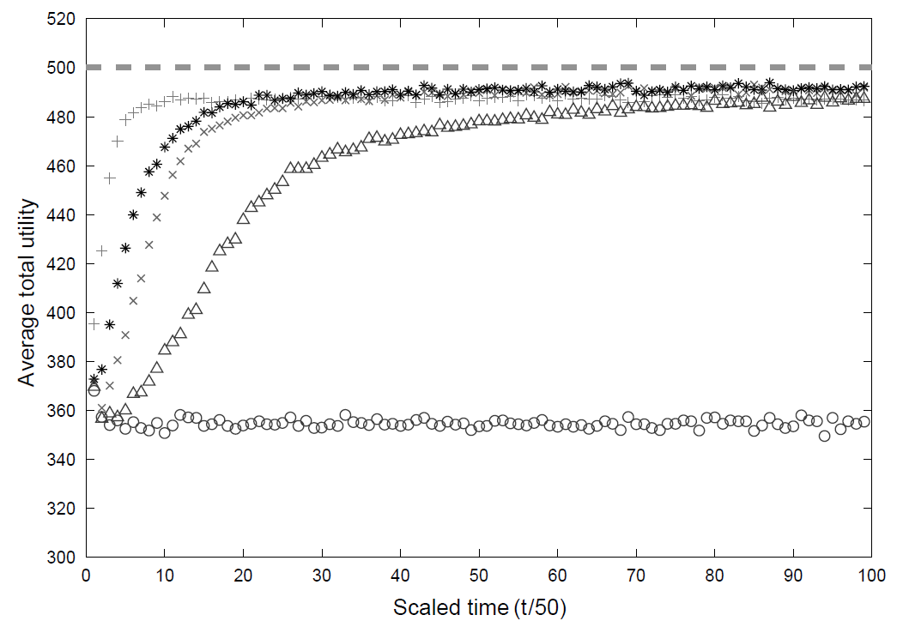
More Experiments
τ = 10, n = 0.6
τ = 50, n = 0.6
τ = 10, n = 0.2
τ = 50, n = 0.2
Basic Minority Game
The time of adaptation has to be optimal (not too frequent or slow).

Slide 42
Strategy Pool Experiments
Experiments on the strategy pools of the agents:
Best two
Random two
Worst two
Operation a:
Operation b:
Operation c:
Operation d:

Slide 43
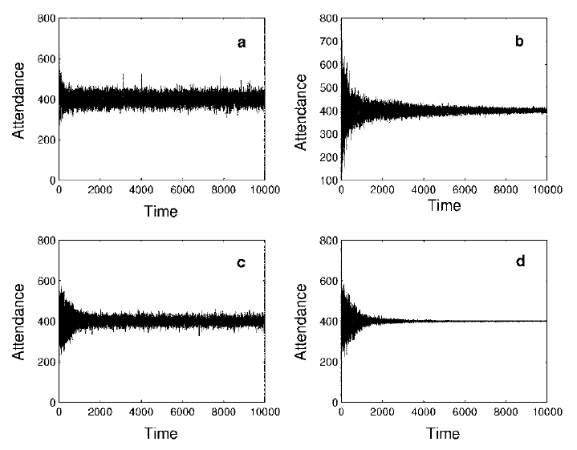
Results
Best two
Random two
Worst two
Operation a:
Operation b:
Operation c:
Operation d:
Operation d is most efficient.

Slide 44
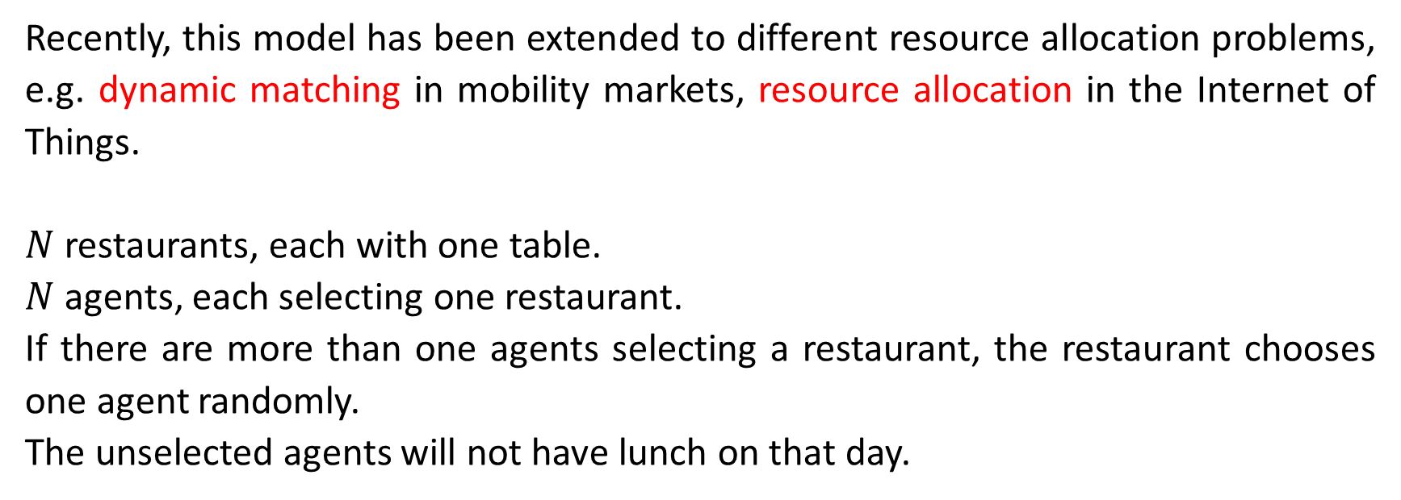
5. The Kolkata Paise Restaurant Problem³
Recently, this model has been extended to different resource allocation problems, e.g. dynamic matching in mobility markets, resource allocation in the Internet of Things.
$N$ restaurants, each with one table.
$N$ agents, each selecting one restaurant.
If there are more than one agents selecting a restaurant, the restaurant chooses one agent randomly.
The unselected agents will not have lunch on that day.
³ Chakraborti AS, Chakrabarti BK, Chatterjee A, and Mitra M (2009) The Kolkata Paise Restaurant Problem and resource utilization. Physica A 288 2420-2426..

Slide 45
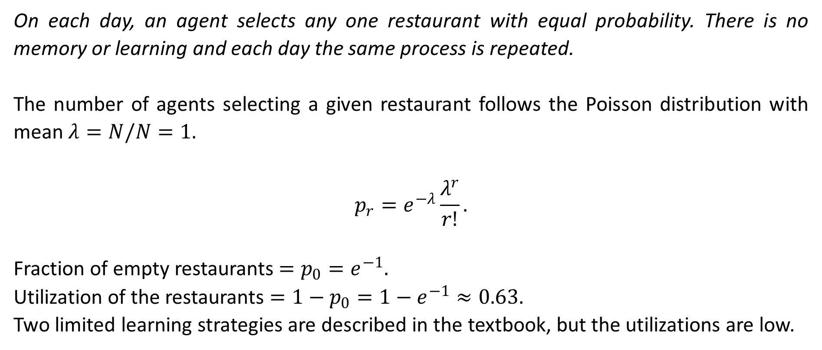
5.1. Repeated Game: No-Learning Strategy
On each day, an agent selects any one restaurant with equal probability. There is no memory or learning and each day the same process is repeated.
The number of agents selecting a given restaurant follows the Poisson distribution with mean $λ=N/N=1.$
$$p_{r}=e^{−λ}\frac{λ^{r}}{r!}.$$
Fraction of empty restaurants $=p_{0}=e^{−1}.$
Utilization of the restaurants $=1−p_{0}=1−e^{−1}≈0.63.$
Two limited learning strategies are described in the textbook, but the utilizations are low.

Slide 46
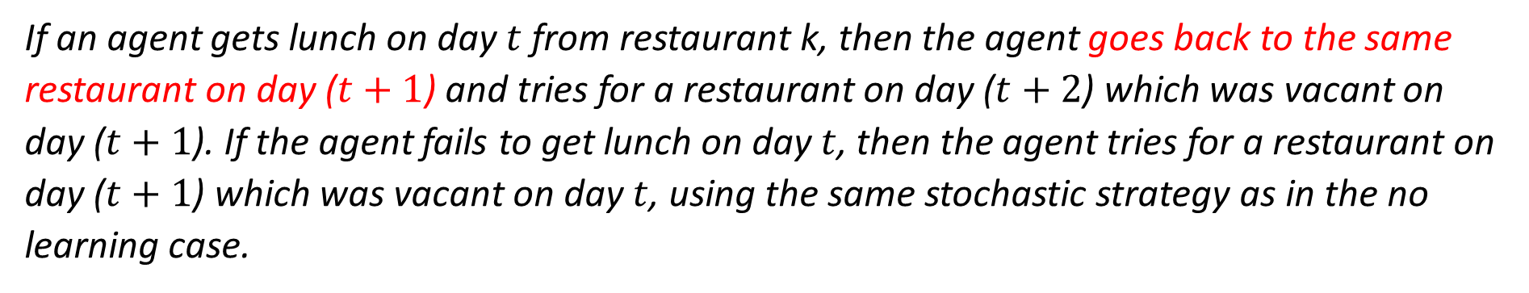
5.2. Repeated Game: One Period Limited Learning Strategy
If an agent gets lunch on day $t$ from restaurant k, then the agent goes back to the same restaurant on day ($t+1$) and tries for a restaurant on day ($t+2$) which was vacant on day ($t+1$). If the agent fails to get lunch on day $t$, then the agent tries for a restaurant on day ($t+1$) which was vacant on day $t$, using the same stochastic strategy as in the no learning case.

Slide 47
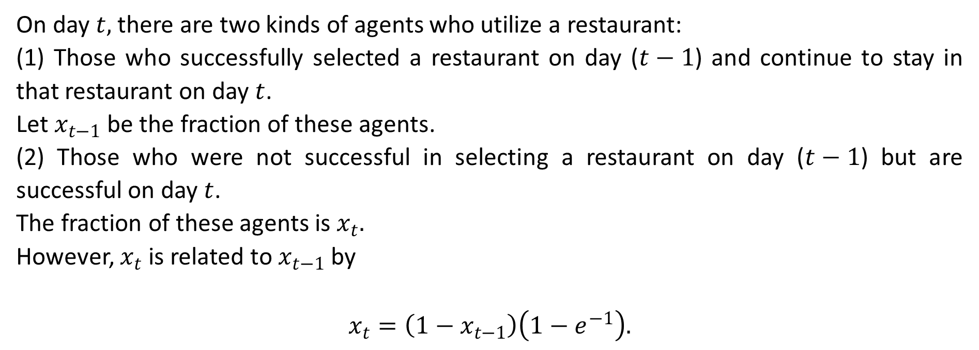
Recursion Relation
On day $t,$ there are two kinds of agents who utilize a restaurant:
(1) Those who successfully selected a restaurant on day ($t−1$) and continue to stay in that restaurant on day $t$.
Let $x_{t−1}$ be the fraction of these agents.
(2) Those who were not successful in selecting a restaurant on day ($t−1$) but are successful on day $t$.
The fraction of these agents is $x_{t}.$
However, $x_{t}$ is related to $x_{t−1}$ by
$$x_{t}=\left(1−x_{t−1}\right)\left(1−e^{−1}\right).$$
Fraction of empty restaurants on the previous day
Utilization of the no-learning strategy

Slide 48
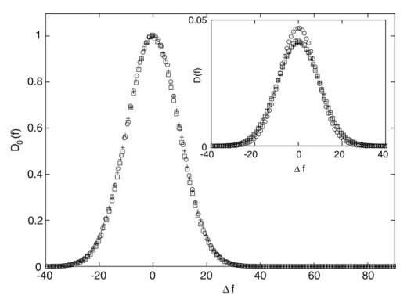
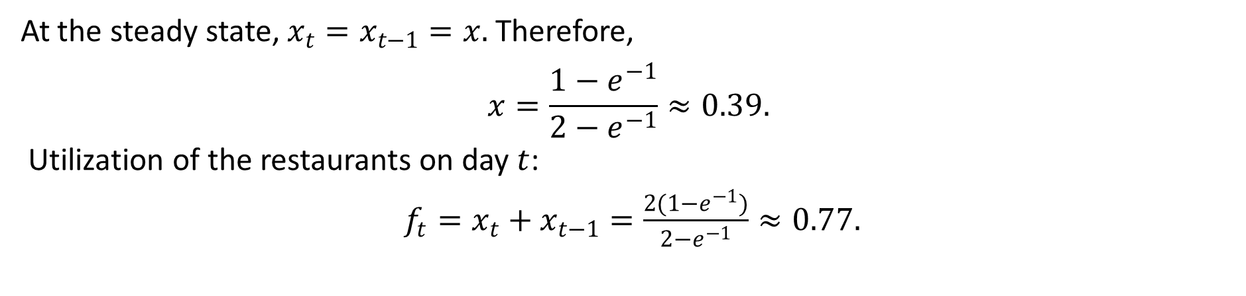
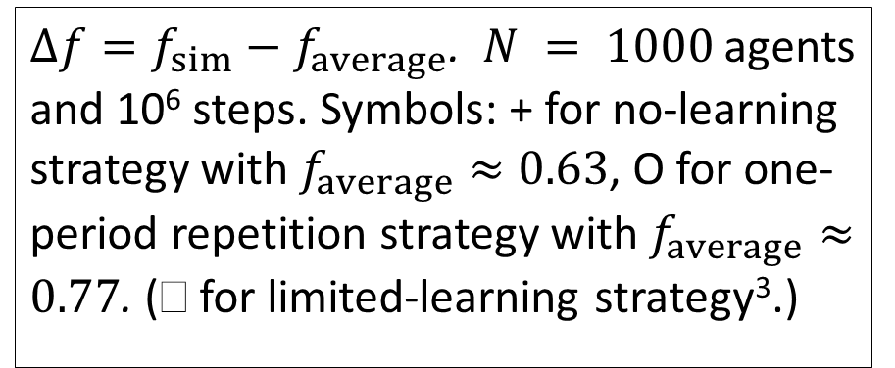
Steady-State Solution
At the steady state, $x_{t}=x_{t−1}=x.$ Therefore,
$$x=\frac{1−e^{−1}}{2−e^{−1}}≈0.39.$$
Utilization of the restaurants on day $t$:
$f_{t}=x_{t}+x_{t−1}=\frac{2(1−e^{−1})}{2−e^{−1}}≈0.77.$
Theoretical prediction agrees with simulation results excellently.
$Δf=f_{sim}−f_{average}$. $N = 1000$agents and 10⁶ steps. Symbols: + for no-learning strategy with $f_{average}≈0.63$, O for one-period repetition strategy with $f_{average}≈0.77$. ( for limited-learning strategy³.)

Slide 49
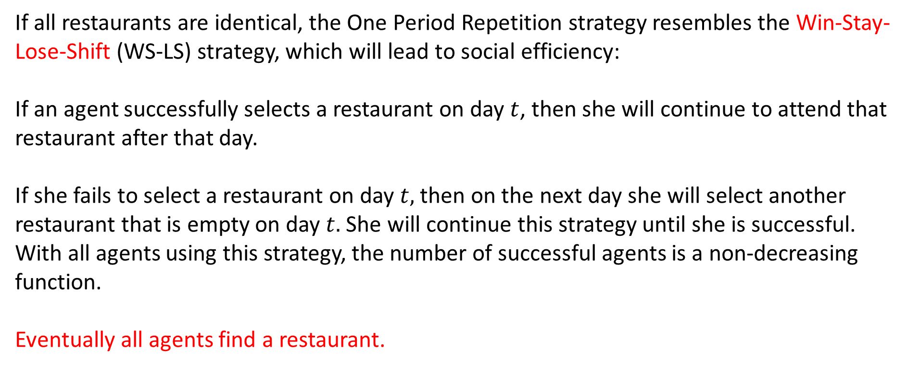
Win-Stay-Lose-Shift
If all restaurants are identical, the One Period Repetition strategy resembles the Win-Stay-Lose-Shift (WS-LS) strategy, which will lead to social efficiency:
If an agent successfully selects a restaurant on day $t$, then she will continue to attend that restaurant after that day.
If she fails to select a restaurant on day $t,$ then on the next day she will select another restaurant that is empty on day $t.$ She will continue this strategy until she is successful.
With all agents using this strategy, the number of successful agents is a non-decreasing function.
Eventually all agents find a restaurant.

Slide 50
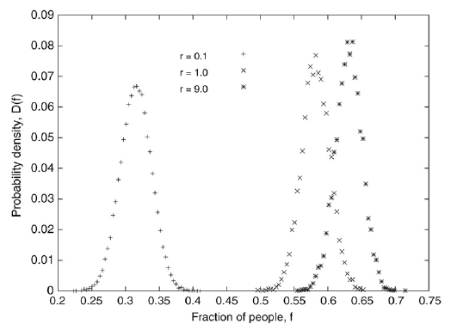
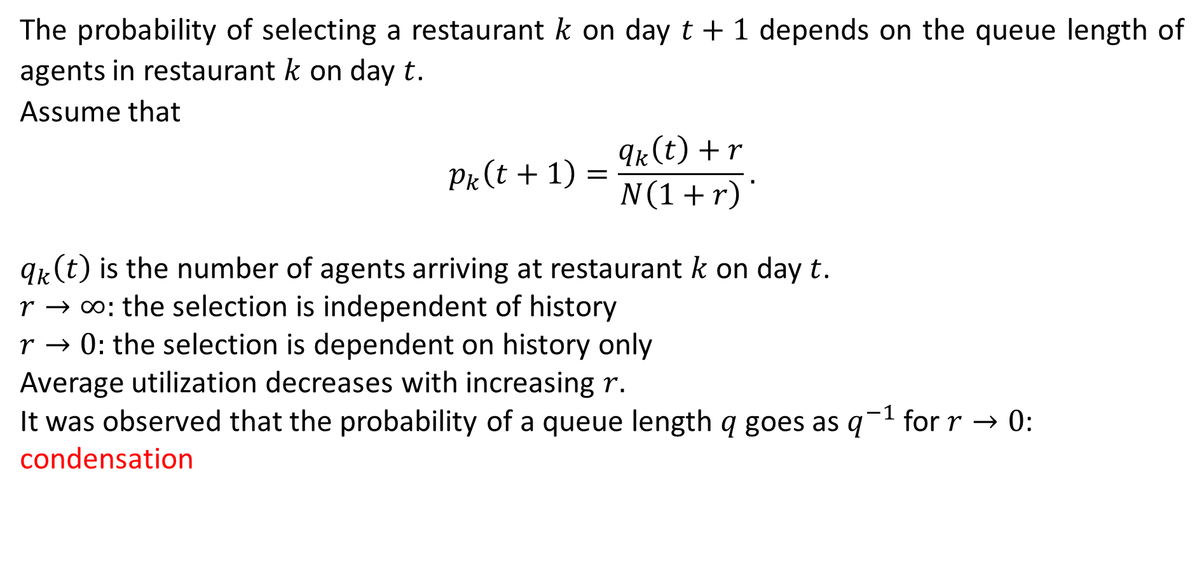
5.3. Follow-the-Crowd Strategy
The probability of selecting a restaurant $k$ on day $t+1$ depends on the queue length of agents in restaurant $k$ on day $t$.
Assume that
$$p_{k}\left(t+1\right)=\frac{q_{k}\left(t\right)+r}{N\left(1+r\right)}.$$
$q_{k}\left(t\right)$ is the number of agents arriving at restaurant $k$ on day $t$.
$r→∞:$ the selection is independent of history
$r→0:$ the selection is dependent on history only
Average utilization decreases with increasing $r.$
It was observed that the probability of a queue length $q$ goes as $q^{−1}$ for $r→0$: condensation

Slide 51
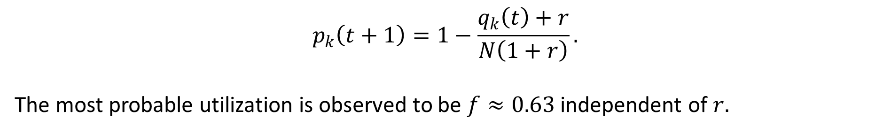
Avoid-the-Crowd Strategy
$$p_{k}\left(t+1\right)=1−\frac{q_{k}\left(t\right)+r}{N\left(1+r\right)}.$$
The most probable utilization is observed to be $f≈0.63$ independent of $r.$

Slide 52
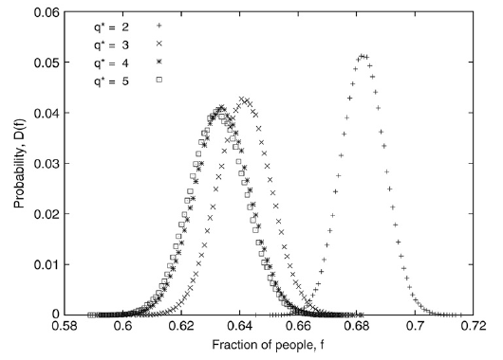
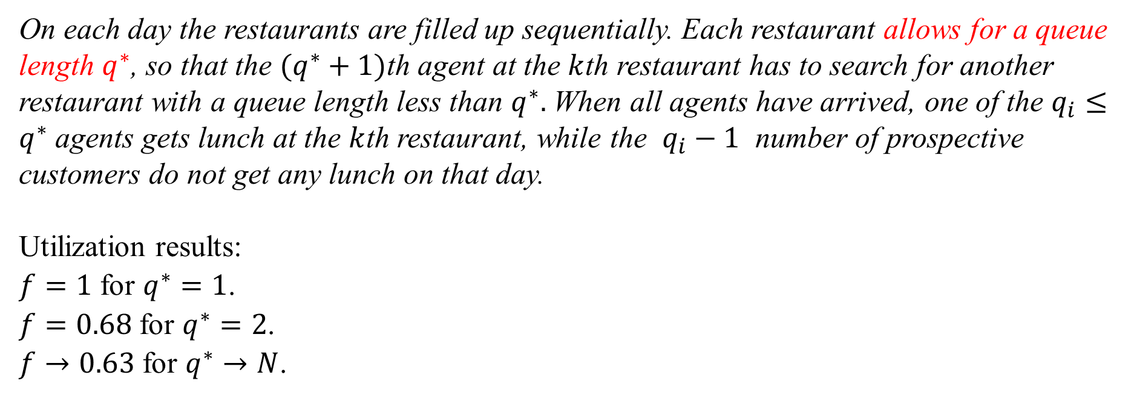
5.4. Modified KPR Problem
On each day the restaurants are filled up sequentially. Each restaurant allows for a queue length $q^{∗}$, so that the $(q^{∗}+1)$th agent at the $k$th restaurant has to search for another restaurant with a queue length less than $q^{∗}.$ When all agents have arrived, one of the $q_{i}≤q^{∗}$ agents gets lunch at the $k$th restaurant, while the $q_{i}−1$ number of prospective customers do not get any lunch on that day.
Utilization results:
$f=1$ for $q^{∗}=1$.
$f=0.68$ for $q^{∗}=2$.
$f→0.63$ for $q^{∗}→N$.

Slide 53
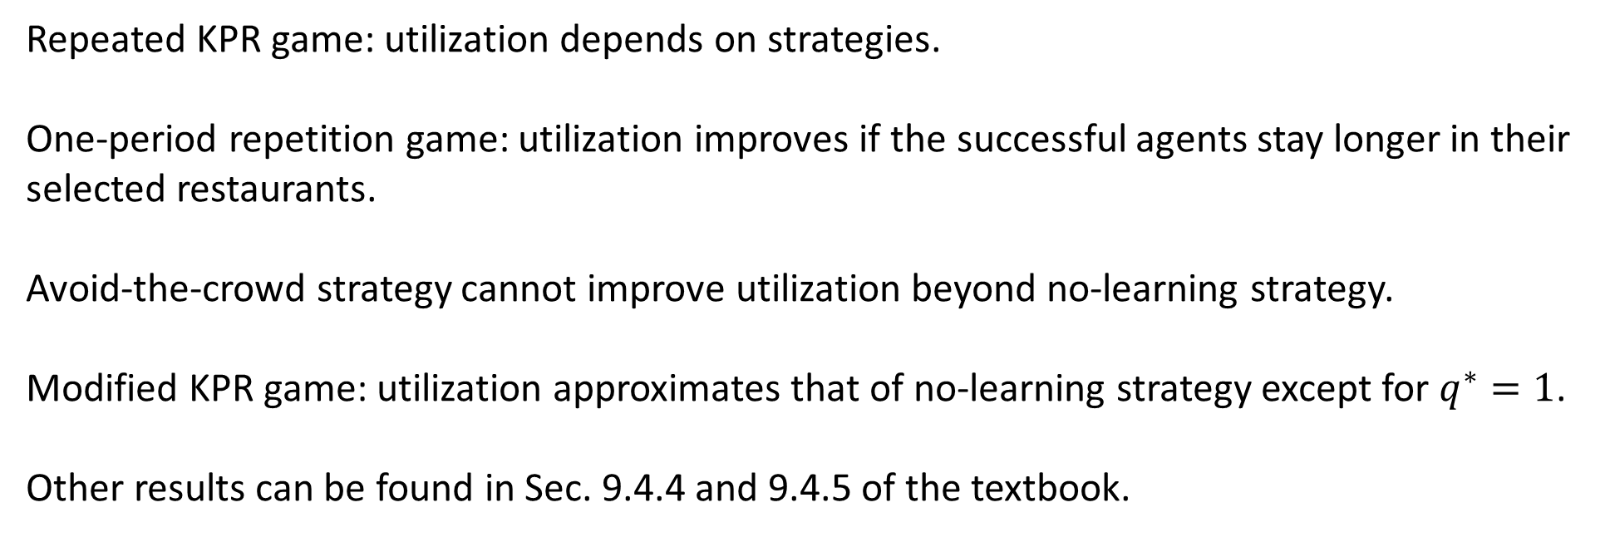
5.5. Summary
Repeated KPR game: utilization depends on strategies.
One-period repetition game: utilization improves if the successful agents stay longer in their selected restaurants.
Avoid-the-crowd strategy cannot improve utilization beyond no-learning strategy.
Modified KPR game: utilization approximates that of no-learning strategy except for $q^{∗}=1$.
Other results can be found in Sec. 9.4.4 and 9.4.5 of the textbook.

Slide 54
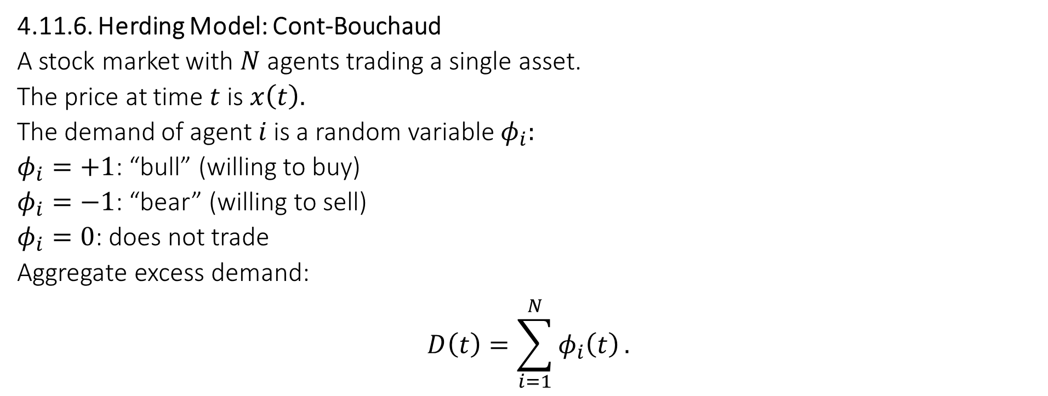
6. Agent-Based Models for Explaining the Power Law for Price Fluctuations
4.11.6. Herding Model: Cont-Bouchaud
A stock market with $N$ agents trading a single asset.
The price at time $t$ is $x\left(t\right).$
The demand of agent $i$ is a random variable $φ_{i}:$
$φ_{i}=+1$: “bull” (willing to buy)
$φ_{i}=−1$: “bear” (willing to sell)
$φ_{i}=0$: does not trade
Aggregate excess demand:
$$D\left(t\right)=\sum_{i=1}^{N}{φ_{i}\left(t\right)}.$$

Slide 55
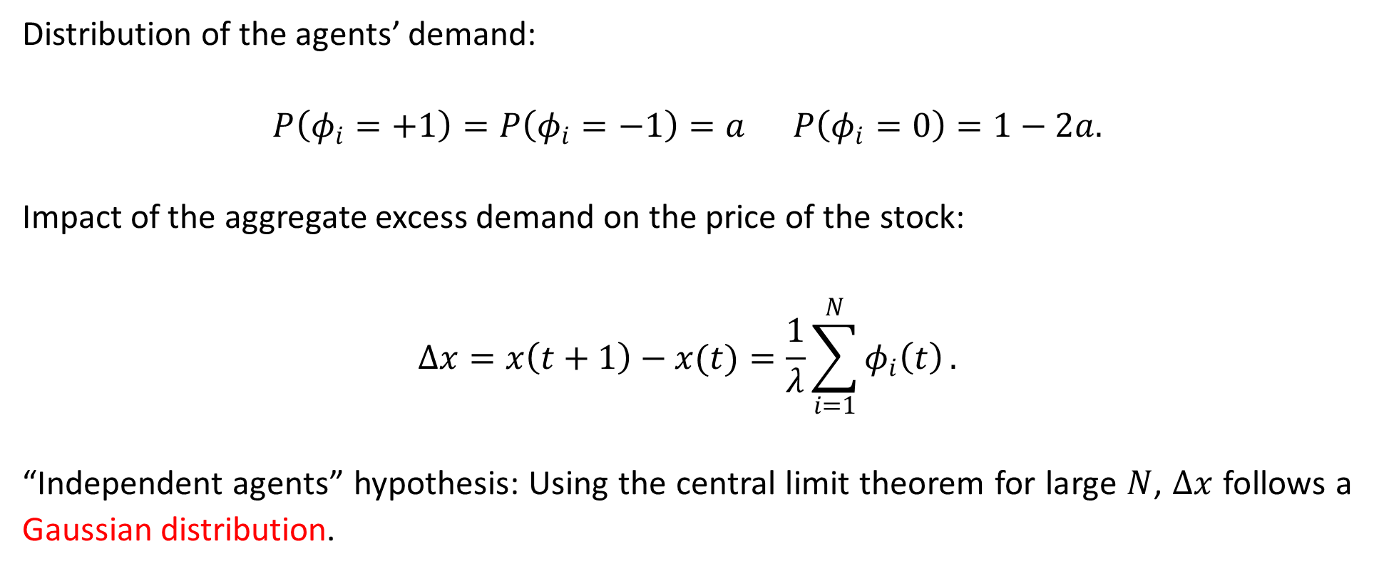
“Independent Agents” Hypothesis
Distribution of the agents’ demand:
$$P\left(φ_{i}=+1\right)=P\left(φ_{i}=−1\right)=a P\left(φ_{i}=0\right)=1−2a.$$
Impact of the aggregate excess demand on the price of the stock:
$$Δx=x\left(t+1\right)−x(t)=\frac{1}{λ}\sum_{i=1}^{N}{φ_{i}\left(t\right)}.$$
“Independent agents” hypothesis: Using the central limit theorem for large $N$, $Δx$ follows a Gaussian distribution.

Slide 56
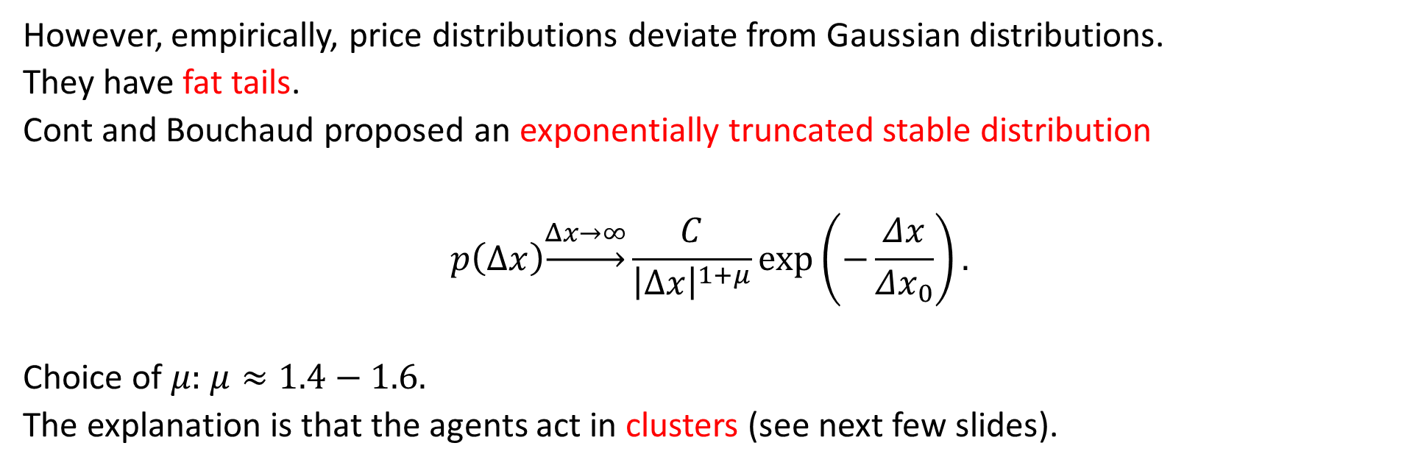
But … Fat Tails
However, empirically, price distributions deviate from Gaussian distributions.
They have fat tails.
Cont and Bouchaud proposed an exponentially truncated stable distribution
$$p\left(Δx\right)\underset{→}{Δx→∞}\frac{C}{{\left|Δx\right|}^{1+μ}}\exp\left(−\frac{Δx}{Δx_{0}}\right).$$
Choice of $μ:$ $μ≈1.4−1.6.$
The explanation is that the agents act in clusters (see next few slides).

Slide 57
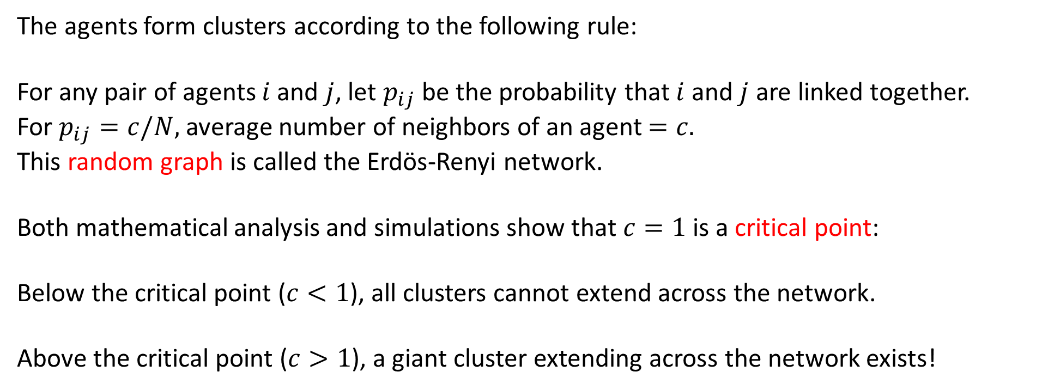
Clusters of Agents
The agents form clusters according to the following rule:
For any pair of agents $i$ and $j$, let $p_{ij}$ be the probability that $i$ and $j$ are linked together.
For $p_{ij}=c/N,$ average number of neighbors of an agent $=c.$
This random graph is called the Erdös-Renyi network.
Both mathematical analysis and simulations show that $c=1$ is a critical point:
Below the critical point ($c<1$), all clusters cannot extend across the network.
Above the critical point ($c>1$), a giant cluster extending across the network exists!

Slide 58
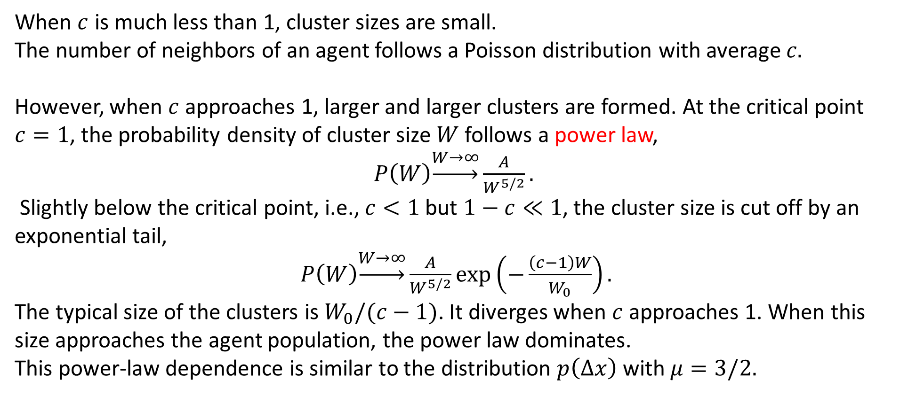
Cluster Size Near the Critical Point
When $c$ is much less than 1, cluster sizes are small.
The number of neighbors of an agent follows a Poisson distribution with average $c.$
However, when $c$ approaches 1, larger and larger clusters are formed. At the critical point $c=1$, the probability density of cluster size $W$ follows a power law,
$P\left(W\right)\underset{→}{W→∞}\frac{A}{W^{5/2}}.$
Slightly below the critical point, i.e., $c<1$ but $1−c≪1$, the cluster size is cut off by an exponential tail,
$P\left(W\right)\underset{→}{W→∞}\frac{A}{W^{5/2}}\exp\left(−\frac{\left(c−1\right)W}{W_{0}}\right).$
The typical size of the clusters is $W_{0}/(c−1)$. It diverges when $c$ approaches 1. When this size approaches the agent population, the power law dominates.
This power-law dependence is similar to the distribution $p\left(Δx\right)$ with $μ=3/2.$

Slide 59
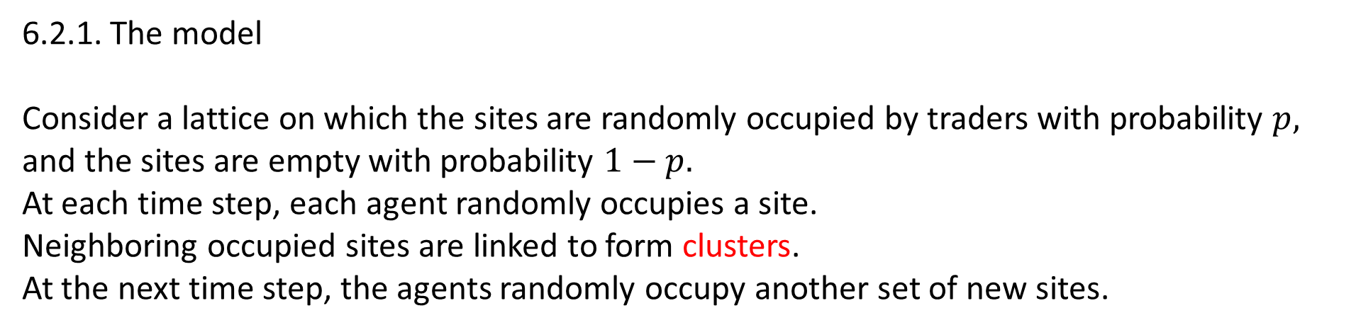
6.2. Cont-Bouchaud Model on a Lattice: Percolation Model
6.2.1. The model
Consider a lattice on which the sites are randomly occupied by traders with probability $p,$ and the sites are empty with probability $1−p.$
At each time step, each agent randomly occupies a site.
Neighboring occupied sites are linked to form clusters.
At the next time step, the agents randomly occupy another set of new sites.

Slide 60
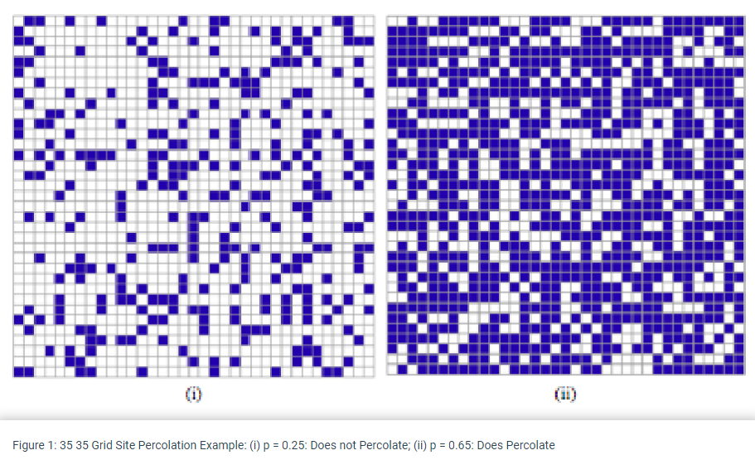
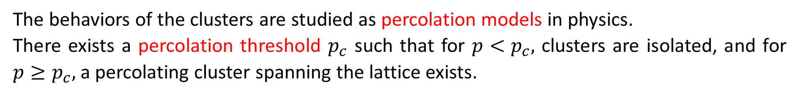
11.6.2.2. Background Knowledge
The behaviors of the clusters are studied as percolation models in physics.
There exists a percolation threshold $p_{c}$ such that for $p<p_{c},$ clusters are isolated, and for $p≥p_{c},$ a percolating cluster spanning the lattice exists.

Slide 61
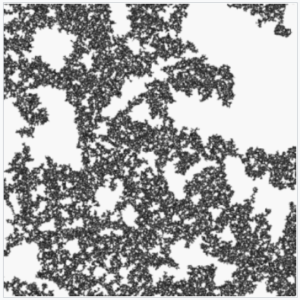
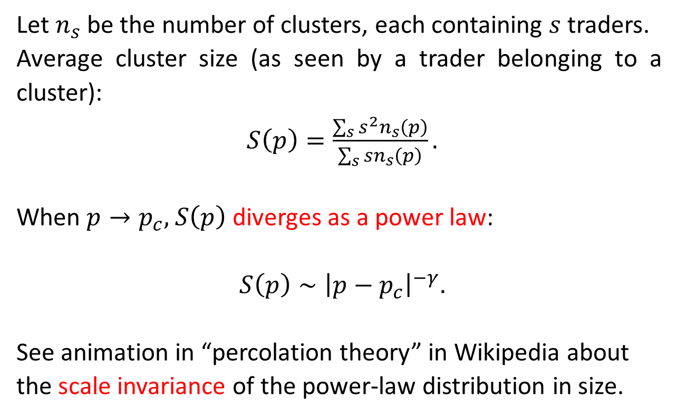
Average Cluster Size at Critical Point
Let $n_{s}$ be the number of clusters, each containing $s$ traders.
Average cluster size (as seen by a trader belonging to a cluster):
$S\left(p\right)=\frac{\sum_{s}{s^{2}n_{s}\left(p\right)}}{\sum_{s}{sn_{s}\left(p\right)}}.$
When $p→p_{c},$ $S\left(p\right)$ diverges as a power law:
$S\left(p\right)∼{\left|p−p_{c}\right|}^{−γ}.$
See animation in “percolation theory” in Wikipedia about the scale invariance of the power-law distribution in size.

Slide 62
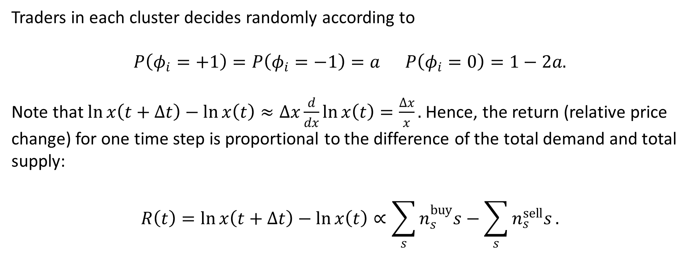
6.2.3. Herding Market Model
Traders in each cluster decides randomly according to
$$P\left(φ_{i}=+1\right)=P\left(φ_{i}=−1\right)=a P\left(φ_{i}=0\right)=1−2a.$$
Note that $\ln{x\left(t+Δt\right)}−\ln{x\left(t\right)}≈Δx\frac{d}{dx}\ln{x\left(t\right)}=\frac{Δx}{x}.$ Hence, the return (relative price change) for one time step is proportional to the difference of the total demand and total supply:
$$R\left(t\right)=\ln{x\left(t+Δt\right)}−\ln{x\left(t\right)}∝\sum_{s}{n_{s}^{buy}s}−\sum_{s}{n_{s}^{sell}s}.$$

Slide 63
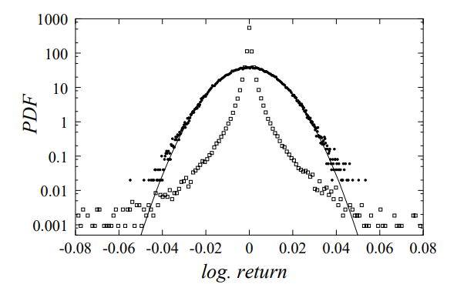
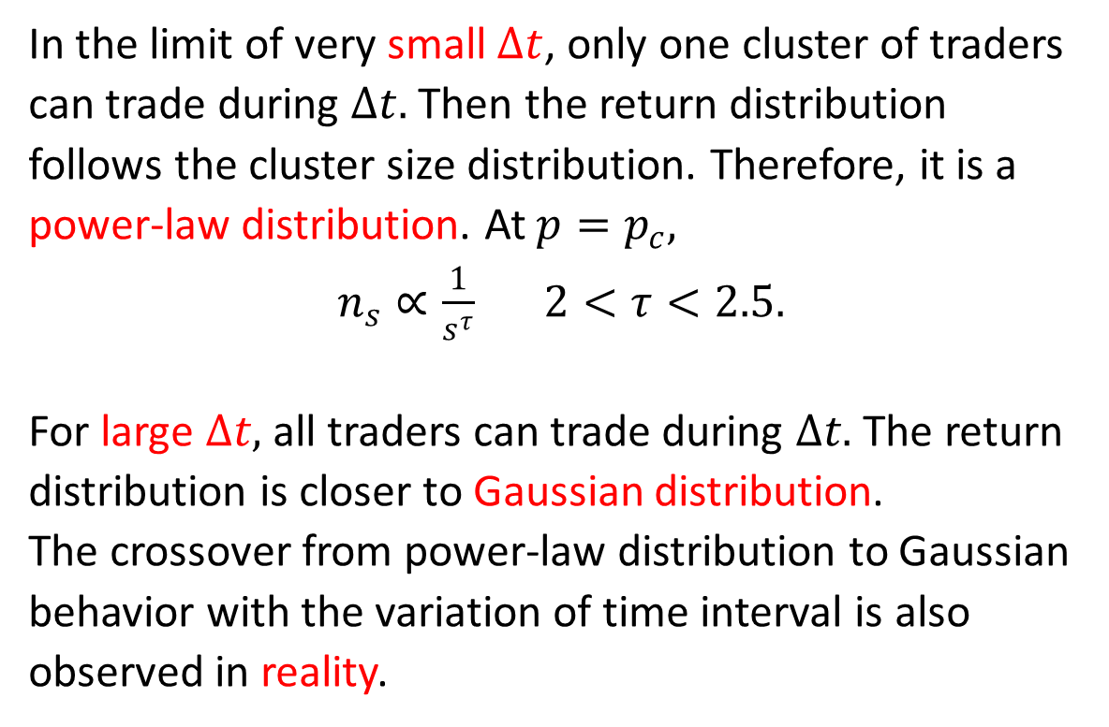
Short and Long Time Limits
In the limit of very small $Δt$, only one cluster of traders can trade during $Δt.$ Then the return distribution follows the cluster size distribution. Therefore, it is a power-law distribution. At $p=p_{c},$
$n_{s}∝\frac{1}{s^{τ}} 2<τ<2.5.$
For large $Δt,$ all traders can trade during $Δt.$ The return distribution is closer to Gaussian distribution.
The crossover from power-law distribution to Gaussian behavior with the variation of time interval is also observed in reality.

